Slide 1







Slide 2
目标是 scoop 软件维护 大 师!
😎😎😎😎😎😎😎😎😎😎😎😎😎😎

Slide 3
敷衍了事的大纲
- 配置文件怎么写
- 怎么创建自己的仓库

Slide 4
怎么添加一个新软件？
https://github.com/ScoopInstaller/Scoop/wiki/App-Manifests
创建 llrt.json
运行 scoop install llrt.json
{
"version": "1.16.1",
"description": "Share files to nearby devices. An open source cross-platform alternative to AirDrop.",
"homepage": "https://localsend.org/",
"license": "Apache-2.0",
"architecture": {
"64bit": {
"url": "https://github.com/localsend/localsend/releases/download/v1.16.1/LocalSend-1.16.1-windows-x86-64.zip",
"hash": "4d9bd4639476c0e4d00dd9da30b7ca78a1dc6e3dafc69e2e8862fdafcc23e163"
}
},
"checkver": {
"github": "https://github.com/localsend/localsend"
},
"autoupdate": {
"architecture": {
"64bit": {
"url": "https://github.com/localsend/localsend/releases/download/v$version/LocalSend-$version-windows-x86-64.zip"
}
}
}
}

Slide 5
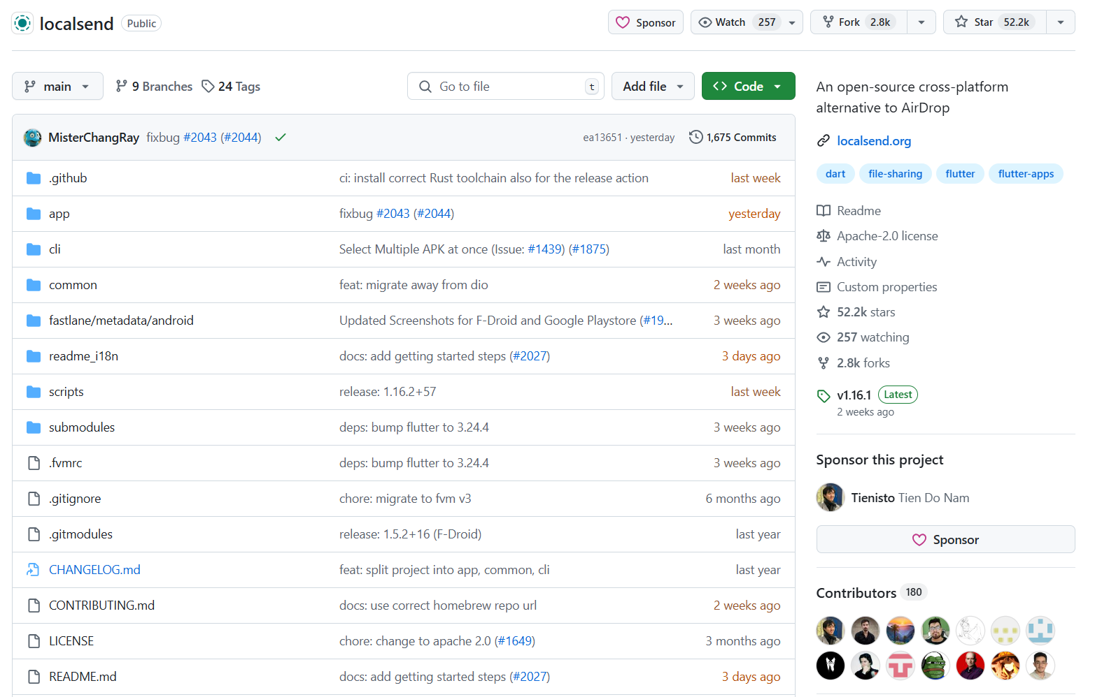
一. 版本号检查
"checkver": {
"github": "https://github.com/localsend/localsend"
},
https://github.com/ScoopInstaller/Scoop/wiki/App-Manifest-Autoupdate#adding-checkver-to-a-manifest

Slide 6
版本号不符合一般的格式？
{ "version": "0.3.0-beta", "homepage": "https://github.com/awslabs/llrt", "architecture": { "64bit": { "url": "https://github.com/awslabs/llrt/releases/download/v0.3.0-beta/llrt-windows-x64.zip", } }, "checkver": { "github": "https://github.com/awslabs/llrt", "regex": "/releases/tag/(?:v|V)?([\\d.]+-beta)" },
}

Slide 7
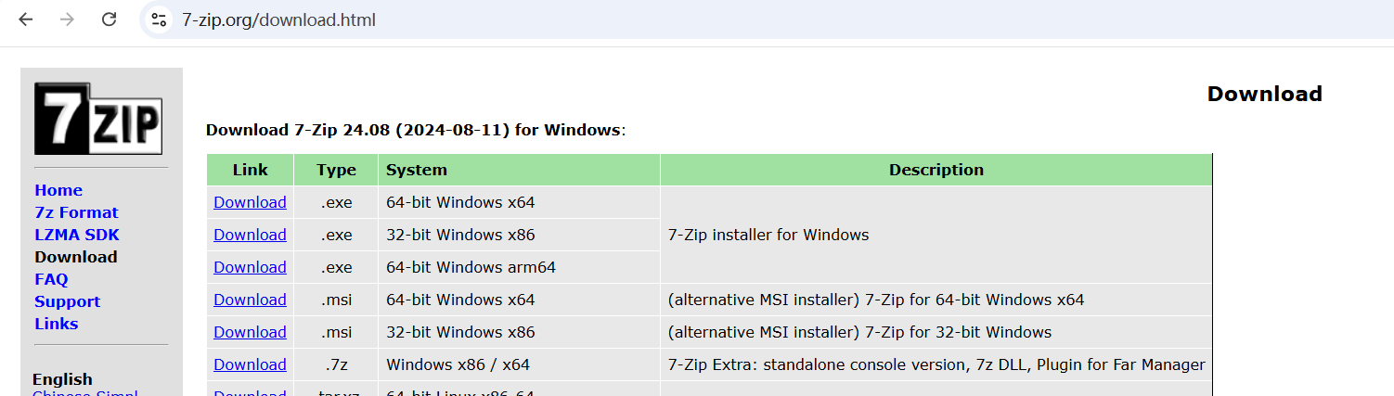
不是 github？
"checkver": {
"url": "https://www.7-zip.org/download.html",
"regex": "Download 7-Zip ([\\d.]+)"
}

Slide 8
[补充] 正则表达式
https://regex101.com/
Download 7-Zip 24.08 (2024-08-11) for Windows:
Download 7-Zip (\d+\.\d+)
\S (不是空白)
\d (数字)
. （任何东西）
? （0 或 1 个）
+ (> 1 个)
* (任意个)

Slide 9
二. Hash 怎么填？
"architecture": {
"64bit": {
"url": "https://github.com/localsend/localsend/releases/download/v1.16.1/LocalSend-1.16.1-windows-x86-64.zip",
"hash": "4d9bd4639476c0e4d00dd9da30b7ca78a1dc6e3dafc69e2e8862fdafcc23e163"
}
},
- 先填写一个错的
- scoop install 安装一次，等待报错
- 把报错里面的正确的 hash 值填过来

Slide 10
[补充] hash (哈希)
Hash 是一种映射关系
## 典型 hash 算法
## ubuntu 镜像举例
https://mirror.nju.edu.cn/ubuntu-releases/releases/24.10
## hash 碰撞举例
https://www.cnblogs.com/Ressurection-20191320/p/16123068.html
y = 2x
1 -> 2
2 -> 4
'123456' -> '234567'
'123456' -> '31230'
常见算法: MD5，SHA256

Slide 11
案例
用途: 签名 (大文件文件下载后是否正确)
1. go 语言下载第三方代码库，下载未实际完成（只有一个空文件夹）
程序无法运行
重新下载提示 已经下载
通过手动寻找并删除空文件夹解决

Slide 12
三. 自动更新
"autoupdate": {
"architecture": {
"64bit": {
"url": "https://github.com/localsend/localsend/releases/download/v$version/LocalSend-$version-windows-x86-64.zip"
}
}
}

Slide 13
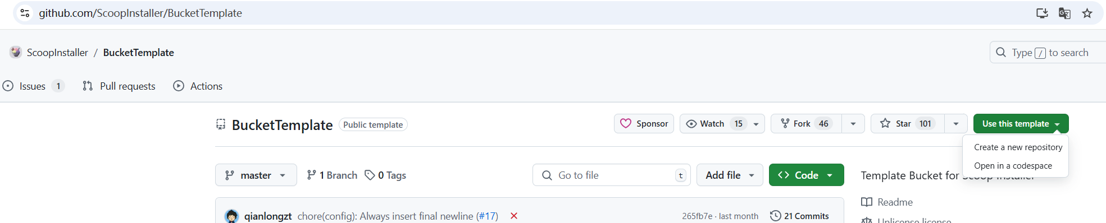
四. 建仓
https://github.com/ScoopInstaller/Scoop/wiki/Buckets#creating-your-own-bucket
https://github.com/io-club/scoop-bucket

Slide 14
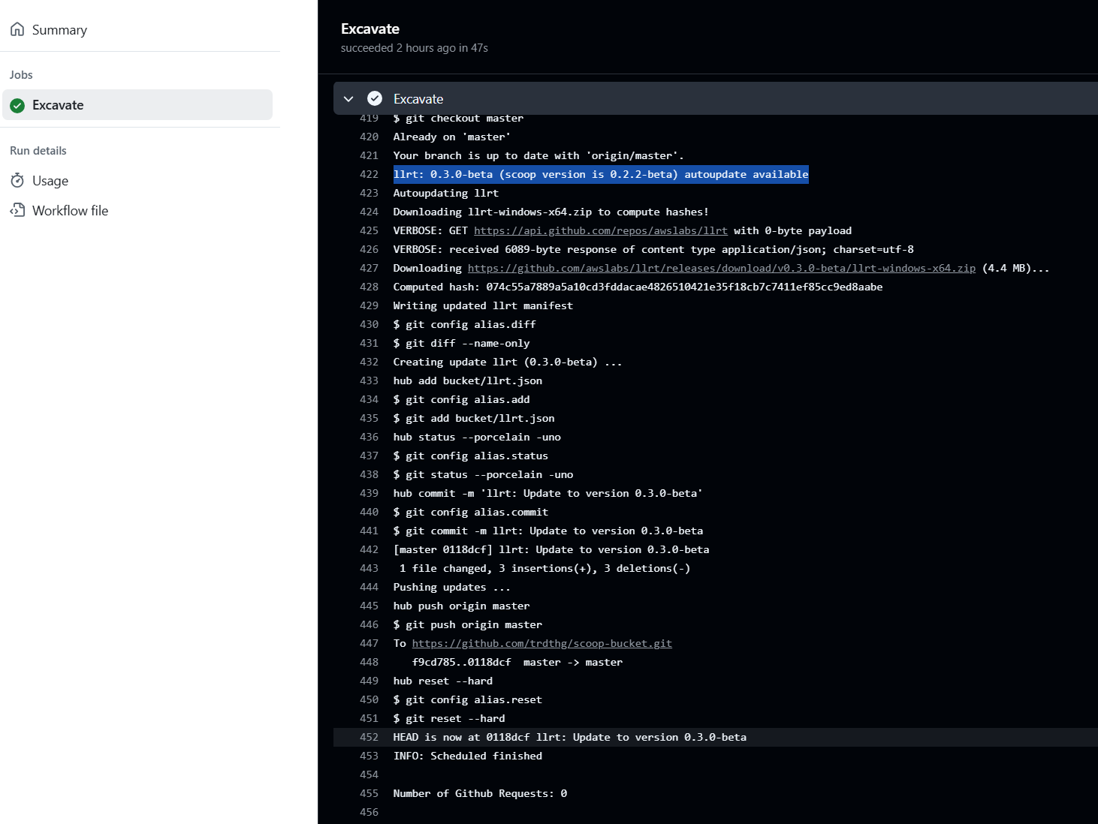

Slide 15
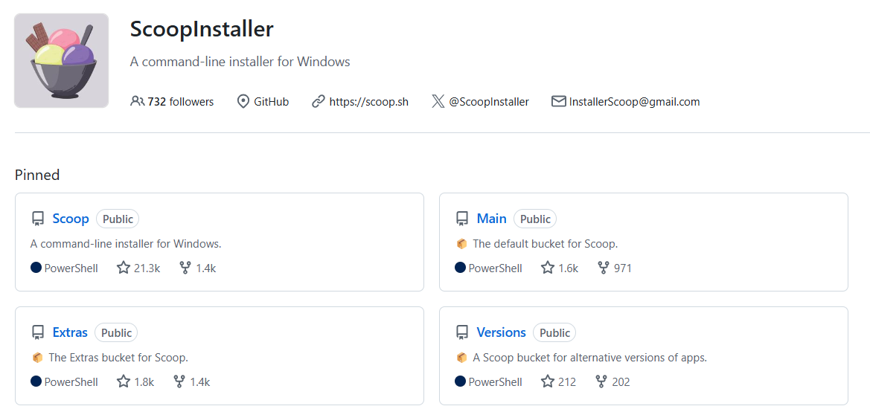
五: 推送到上游
https://github.com/ScoopInstaller/Main/issues

Slide 16
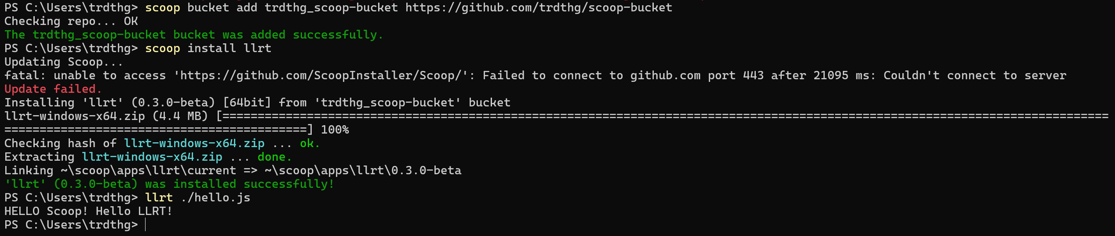
使用例

